Slide 1
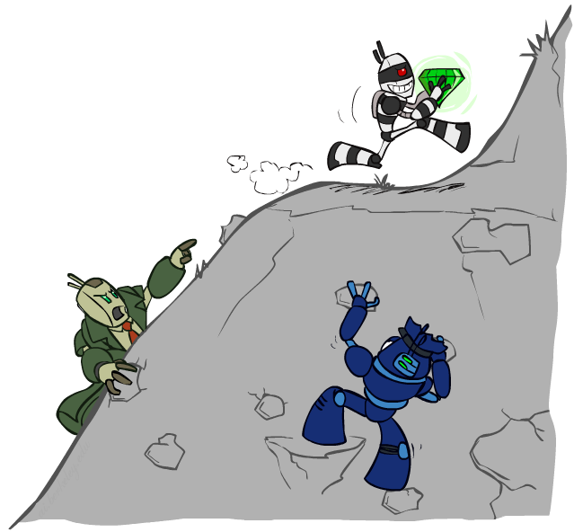
CS 188: Artificial Intelligence
Constraint Satisfaction Problems II
Instructor: Anca Dragan
University of California, Berkeley
Slides by Dan Klein, Pieter Abbeel, Anca Dragan (ai.berkeley.edu)
Notes:
Please retain proper attribution, including the reference to ai.berkeley.edu. Thanks!

Slide 2

Today
Efficient Solution of CSPs
Local Search

Slide 3

Constraint Satisfaction Problems
N variables
domain D
constraints
x₂
x₁

Slide 4

Standard Search Formulation
Standard search formulation of CSPs
States defined by the values assigned so far (partial assignments)
Initial state: the empty assignment, {}
Successor function: assign a value to an unassigned variable
Goal test: the current assignment is complete and satisfies all constraints
We started with the straightforward, naïve approach, then improved it

Slide 5

Backtracking Search

Slide 6
Backtracking Search
1. fix ordering
2. check constraints as you go
[Demo: coloring -- backtracking]

Slide 7
Explain it to your rubber duck!
Why is it ok to fix the ordering of variables?
Why is it good to fix the ordering of variables?

Slide 8

Filtering
Keep track of domains for unassigned variables and cross off bad options

Slide 9
Filtering: Forward Checking
Filtering: Keep track of domains for unassigned variables and cross off bad options
Forward checking: Cross off values that violate a constraint when added to the existing assignment
WA
NT
Q
SA
NSW
V
[Demo: coloring -- forward checking]
Notes:
Demo:
CS188 javascript demos -> source -> exercises -> csps -> CSPs demos -> CSPs demos.html
Settings:
Graph = Simple
Algorithm = Backtracking
Ordering = None
Filtering = Forward Checking

Slide 10
Filtering: Constraint Propagation
Forward checking propagates information from assigned to unassigned variables, but doesn't provide early detection for all failures:
NT and SA cannot both be blue!
Why didn’t we detect this yet?
Constraint propagation: reason from constraint to constraint
NT
Q
WA
SA
NSW
V
Notes:
We’ve already failed, but forward checking does not detect that.

Slide 11

Consistency of A Single Arc
An arc X → Y is consistent iff for every x in the tail there is some y in the head which could be assigned without violating a constraint
NT
Q
WA
SA
NSW
V
Delete from the tail!

Slide 12
Arc Consistency of an Entire CSP
A simple form of propagation makes sure all arcs are consistent:
Important: If X loses a value, neighbors of X need to be rechecked!
Arc consistency detects failure earlier than forward checking
Can be run as a preprocessor or after each assignment
What’s the downside of enforcing arc consistency?
NT
Q
WA
SA
NSW
V
Remember: Delete from the tail!
Notes:
remids you of a* - heuristic takes time

Slide 13
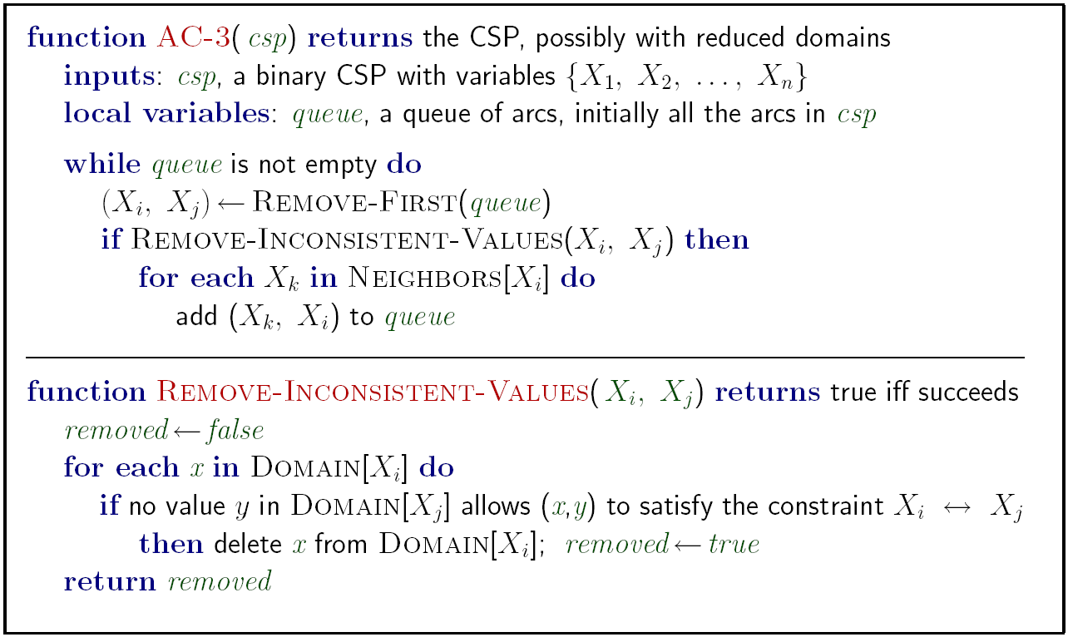
Enforcing Arc Consistency in a CSP
Runtime: O(n²d³), can be reduced to O(n²d²)
… but detecting all possible future problems is NP-hard – why?
Notes:
Auto-consistency (note initially nothing gets deleted/pruned since there are consistent options for all constraints for initial variable domains)
Flashes whenever something needs to be re-checked
Note: If you want to cut down on the worst case from n^2d^3 to n^2d^2, there's a trick where when you check consistency X->Y, for each value x you only go through y values until you find one that works. You stop there. Then, if you have to check it again, either that y value still works, or you continue until a new value does. This way, instead of d^2 d times, you collapse that into just d^2. You can read more here:
http://redwood.cs.ttu.edu/~yuazhang/publications/ac3-1-ijcai01.pdf

Slide 14
Forward Checking – how does it relate?
Forward checking: Cross off values that violate a constraint when added to the existing assignment
WA
NT
Q
SA
NSW
V
[Demo: coloring -- forward checking]
Notes:
Demo:
CS188 javascript demos -> source -> exercises -> csps -> CSPs demos -> CSPs demos.html
Settings:
Graph = Simple
Algorithm = Backtracking
Ordering = None
Filtering = Forward Checking

Slide 15
Explain it to your rubber duck!
Forward checking is a special type of enforcing arc consistency, in which we only enforce the arcs pointing into the newly assigned variable.

Slide 16


Limitations of Arc Consistency
After enforcing arc consistency:
Can have one solution left
Can have multiple solutions left
Can have no solutions left (and not know it)
Arc consistency still runs inside a backtracking search!
[Demo: coloring -- forward checking]
[Demo: coloring -- arc consistency]
Notes:
Demo:
CS188 javascript demos -> source -> exercises -> csps -> CSPs demos -> CSPs demos.html
Settings:
Graph = Complex
Algorithm = Backtracking
Ordering = None
Filtering = Forward Checking (first) / Arc Consistency (second)

Slide 17

Video of Demo Coloring – Backtracking with Forward Checking – Complex Graph

Slide 18
Video of Demo Coloring – Backtracking with Arc Consistency – Complex Graph

Slide 19
K-Consistency
Increasing degrees of consistency
1-Consistency (Node Consistency): Each single node’s domain has a value which meets that node’s unary constraints
2-Consistency (Arc Consistency): For each pair of nodes, any consistent assignment to one can be extended to the other
K-Consistency: For each k nodes, any consistent assignment to k-1 can be extended to the k^{th} node.
Higher k more expensive to compute
(You need to know the k=2 case: arc consistency)

Slide 20
Strong K-Consistency
Strong k-consistency: also k-1, k-2, … 1 consistent
Claim: strong n-consistency means we can solve without backtracking!
Why?
Choose any assignment to any variable
Choose a new variable
By 2-consistency, there is a choice consistent with the first
Choose a new variable
By 3-consistency, there is a choice consistent with the first 2
…
Lots of middle ground between arc consistency and n-consistency! (e.g. k=3, called path consistency)

Slide 21

Ordering

Slide 22
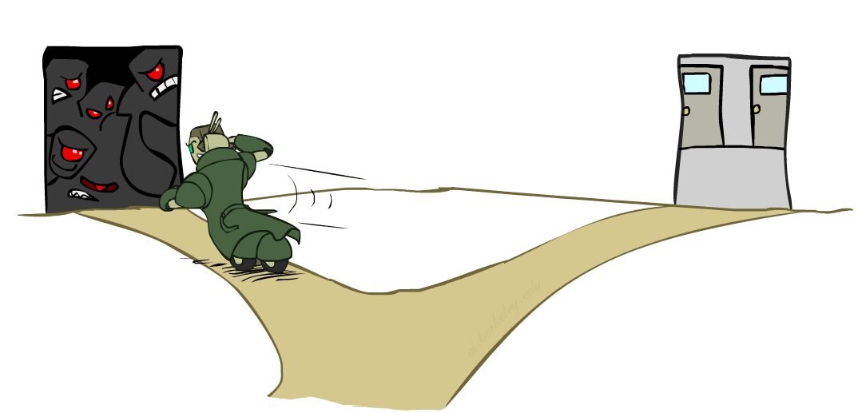
Ordering: Minimum Remaining Values
Variable Ordering: Minimum remaining values (MRV):
Choose the variable with the fewest legal left values in its domain
Why min rather than max?
Also called “most constrained variable”
“Fail-fast” ordering
Notes:
don’t procrastinate

Slide 23
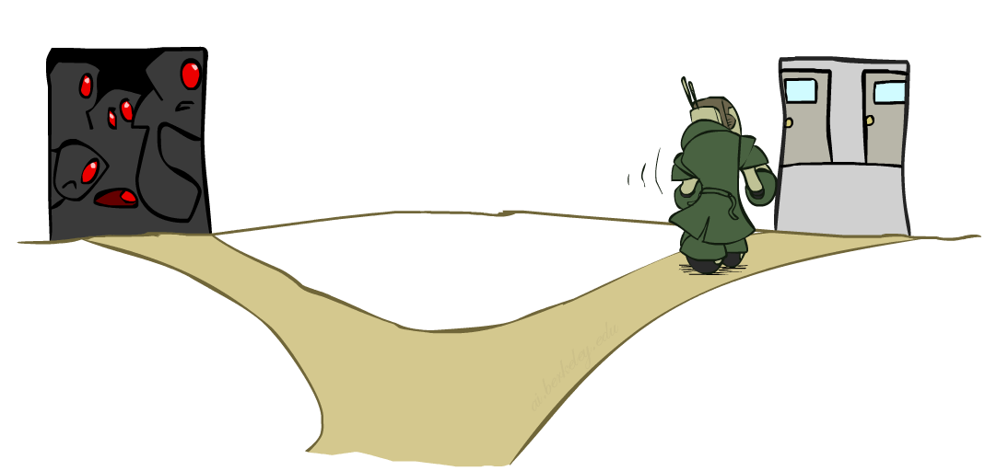
Ordering: Least Constraining Value
Value Ordering: Least Constraining Value
Given a choice of variable, choose the least constraining value
I.e., the one that rules out the fewest values in the remaining variables
Note that it may take some computation to determine this! (E.g., rerunning filtering)
Why least rather than most?
Combining these ordering ideas makes
1000 queens feasible

Slide 24
Demo: Coloring -- Backtracking + Forward Checking + Ordering
Notes:
Demo:
CS188 javascript demos -> source -> exercises -> csps -> CSPs demos -> CSPs demos.html
Settings:
Graph = Complex
Algorithm = Backtracking
Ordering = MRV
Filtering = Forward Checking
Solves already without any need for backtracking
Note: need a bigger problem to illustrate relevance of backtracking+AC+MRV+MCV

Slide 25
Summary
Work with your rubber duck to write down:
How we order variables and why
How we order values and why

Slide 26
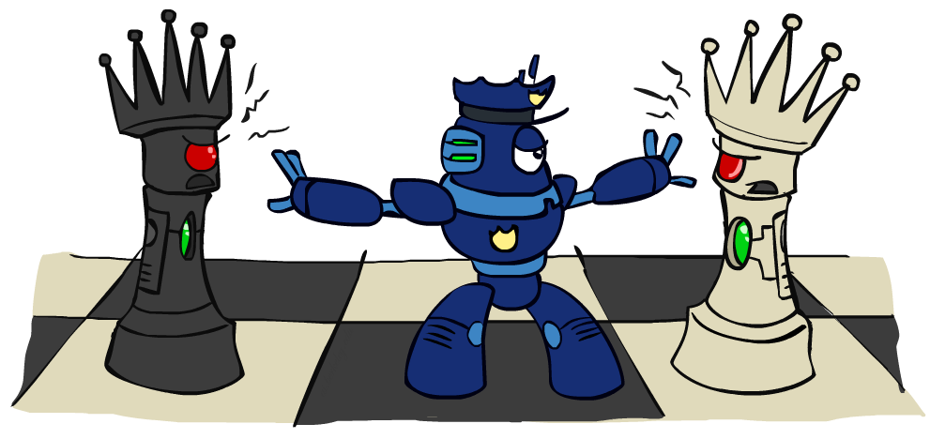
Iterative Improvement

Slide 27

Iterative Algorithms for CSPs
Local search methods typically work with “complete” states, i.e., all variables assigned
To apply to CSPs:
Take an assignment with unsatisfied constraints
Operators reassign variable values
No fringe! Live on the edge.
Algorithm: While not solved,
Variable selection: randomly select any conflicted variable
Value selection: min-conflicts heuristic:
Choose a value that violates the fewest constraints
I.e., hill climb with h(x) = total number of violated constraints

Slide 28
Example: 4-Queens
States: 4 queens in 4 columns (4⁴ = 256 states)
Operators: move queen in column
Goal test: no attacks
Evaluation: c(n) = number of attacks
[Demo: n-queens – iterative improvement (L5D1)]
[Demo: coloring – iterative improvement]
Notes:
L5D1 – python demos
Coloring – javascript demos

Slide 29
Video of Demo Iterative Improvement – n Queens

Slide 30
Video of Demo Iterative Improvement – Coloring

Slide 31
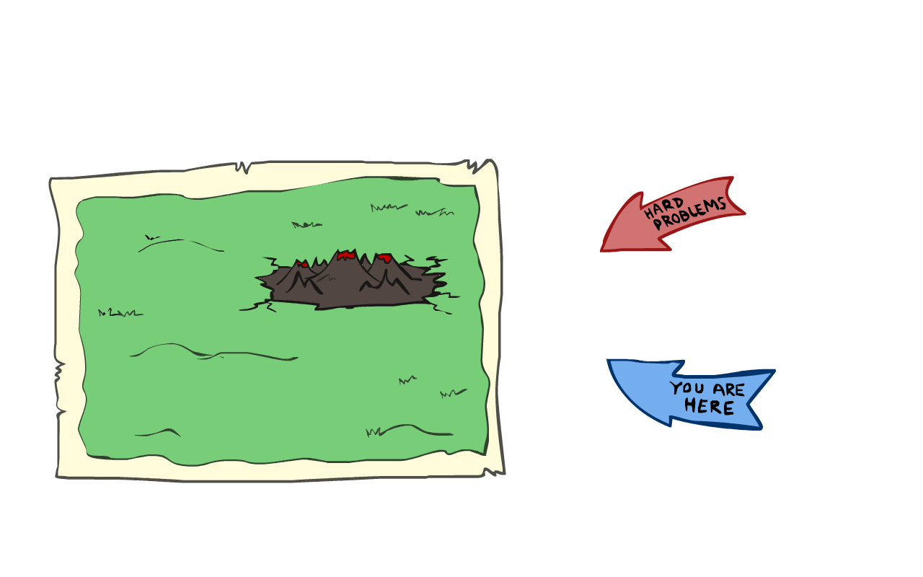
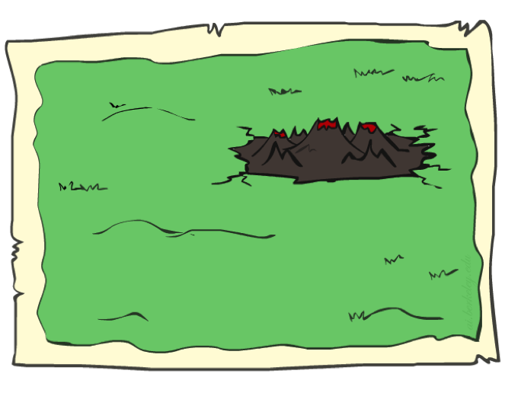
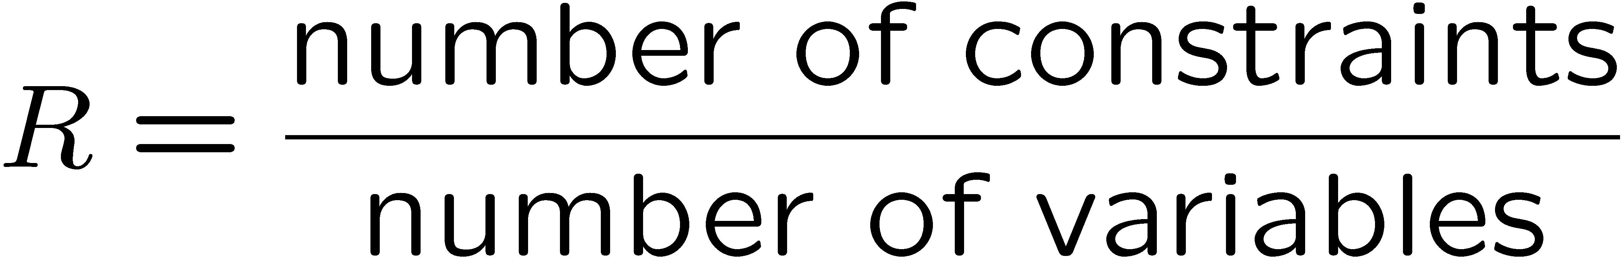
Performance of Min-Conflicts
Given random initial state, can solve n-queens in almost constant time for arbitrary n with high probability (e.g., n = 10,000,000)!
The same appears to be true for any randomly-generated CSP except in a narrow range of the ratio

Slide 32
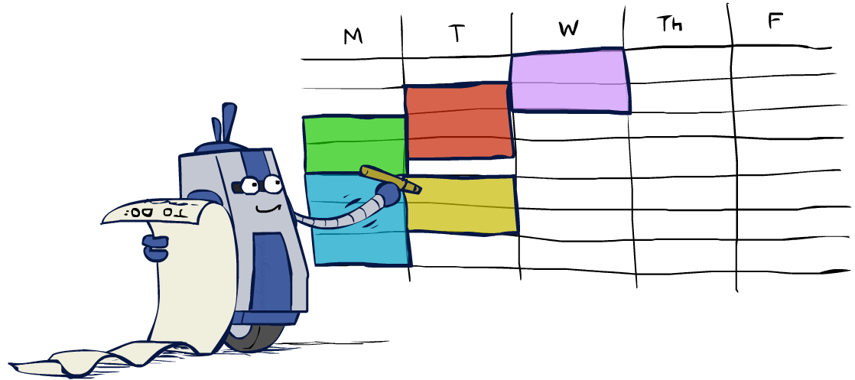
Summary: CSPs
CSPs are a special kind of search problem:
States are partial assignments
Goal test defined by constraints
Basic solution: backtracking search
Speed-ups:
Ordering
Filtering
Structure – turns out trees are easy!
Iterative min-conflicts is often effective in practice

Slide 33
Local Search

Slide 34
Local Search
Tree search keeps unexplored alternatives on the fringe (ensures completeness)
Local search: improve a single option until you can’t make it better (no fringe!)
New successor function: local changes
Generally much faster and more memory efficient (but incomplete and suboptimal)

Slide 35
Hill Climbing
Simple, general idea:
Start wherever
Repeat: move to the best neighboring state
If no neighbors better than current, quit
What’s bad about this approach?
What’s good about it?
Notes:
Ends up on the hill, looks around, it’s better than all neighbors and declares success
not complete, not optim
Neighbors not obvious

Slide 36
Hill Climbing Diagram

Slide 37
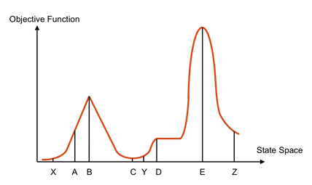
Hill Climbing Quiz
Starting from X, where do you end up ?
Starting from Y, where do you end up ?
Starting from Z, where do you end up ?

Slide 38

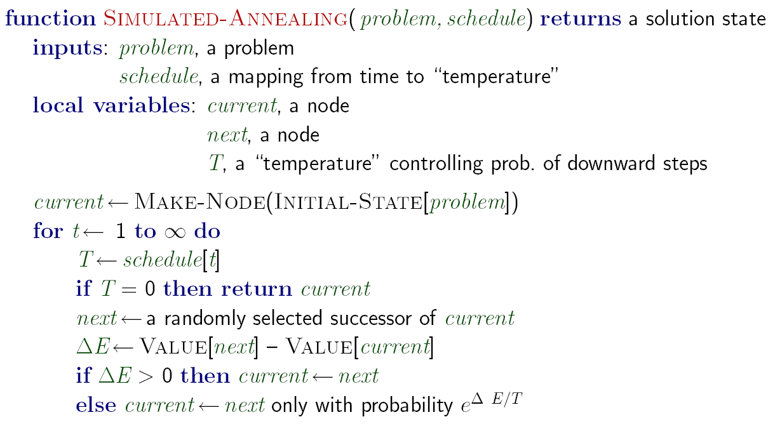
Simulated Annealing
Idea: Escape local maxima by allowing downhill moves
But make them rarer as time goes on

Slide 39
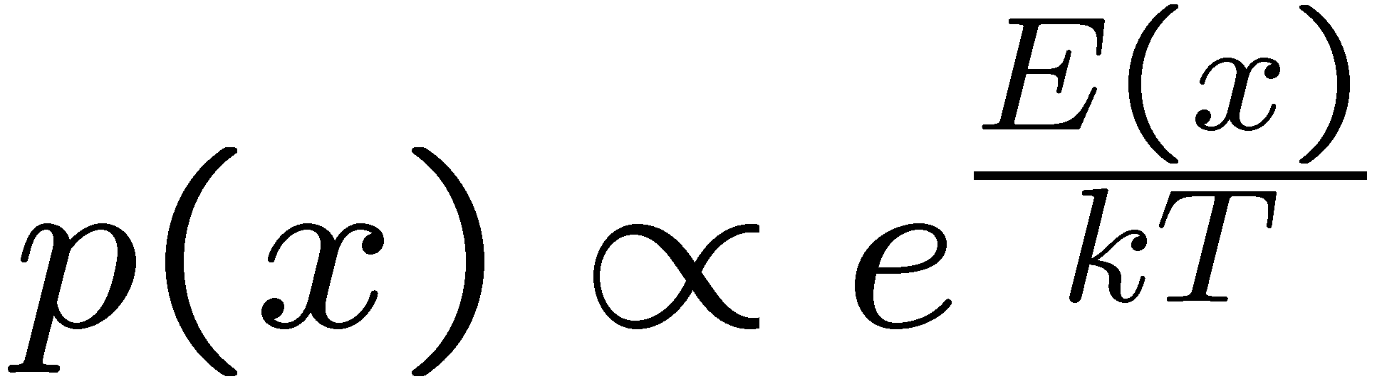
Simulated Annealing
Theoretical guarantee:
Stationary distribution:
If T decreased slowly enough,
will converge to optimal state!
Is this an interesting guarantee?
Sounds like magic, but reality is reality:
The more downhill steps you need to escape a local optimum, the less likely you are to ever make them all in a row
People think hard about ridge operators which let you jump around the space in better ways

Slide 40

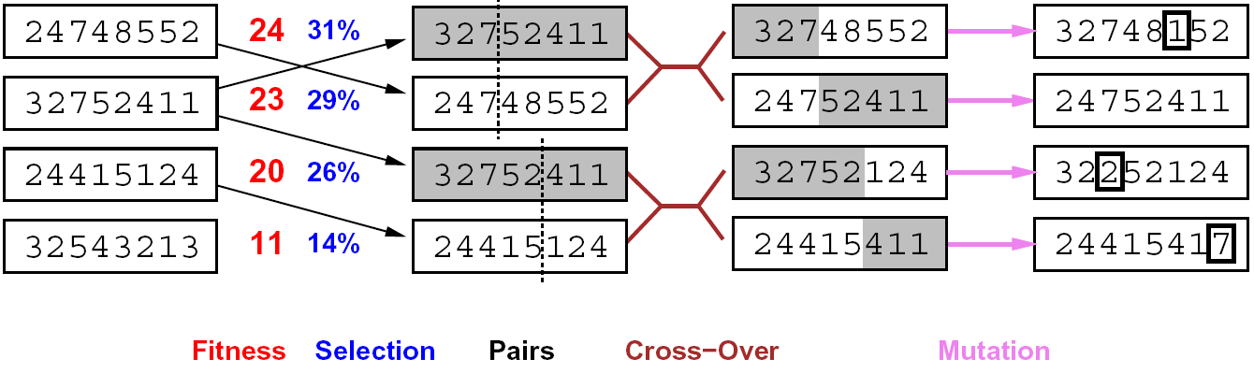
Genetic Algorithms
Genetic algorithms use a natural selection metaphor
Keep best N hypotheses at each step (selection) based on a fitness function
Also have pairwise crossover operators, with optional mutation to give variety
Possibly the most misunderstood, misapplied (and even maligned) technique around

Slide 41
Example: N-Queens
Why does crossover make sense here?
When wouldn’t it make sense?
What would mutation be?
What would a good fitness function be?

Slide 42
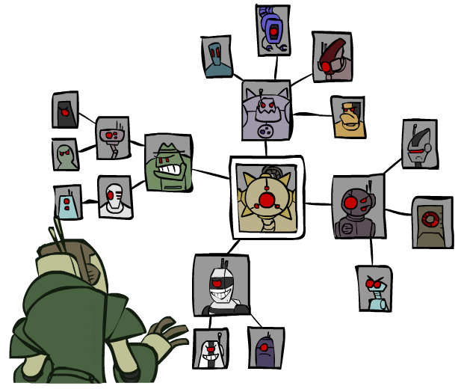
Bonus (time permitting): Structure

Slide 43
Problem Structure
Extreme case: independent subproblems
Example: Tasmania and mainland do not interact
Independent subproblems are identifiable as connected components of constraint graph
Suppose a graph of n variables can be broken into subproblems of only c variables:
Worst-case solution cost is O((n/c)(d^{c})), linear in n
E.g., n = 80, d = 2, c =20
2⁸⁰ = 4 billion years at 10 million nodes/sec
(4)(2²⁰) = 0.4 seconds at 10 million nodes/sec

Slide 44
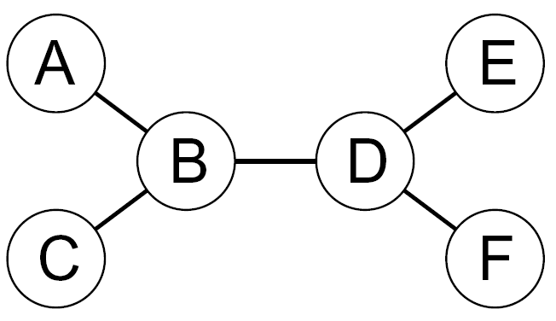
Tree-Structured CSPs
Theorem: if the constraint graph has no loops, the CSP can be solved in O(n d²) time
Compare to general CSPs, where worst-case time is O(d^{n})
This property also applies to probabilistic reasoning (later): an example of the relation between syntactic restrictions and the complexity of reasoning

Slide 45
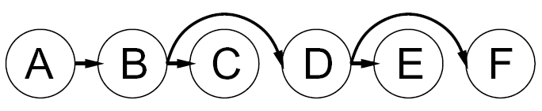


Tree-Structured CSPs
Algorithm for tree-structured CSPs:
Order: Choose a root variable, order variables so that parents precede children
Remove backward: For i = n : 2, apply RemoveInconsistent(Parent(X_{i}),X_{i})
Assign forward: For i = 1 : n, assign X_{i} consistently with Parent(X_{i})
Runtime: O(n d²) (why?)

Slide 46
Tree-Structured CSPs
Claim 1: After backward pass, all root-to-leaf arcs are consistent
Proof: Each X→Y was made consistent at one point and Y’s domain could not have been reduced thereafter (because Y’s children were processed before Y)
Claim 2: If root-to-leaf arcs are consistent, forward assignment will not backtrack
Proof: Induction on position
Why doesn’t this algorithm work with cycles in the constraint graph?
Note: we’ll see this basic idea again with Bayes’ nets

Slide 47

Improving Structure

Slide 48
Nearly Tree-Structured CSPs
Conditioning: instantiate a variable, prune its neighbors' domains
Cutset conditioning: instantiate (in all ways) a set of variables such that the remaining constraint graph is a tree
Cutset size c gives runtime O( (d^{c}) (n-c) d² ), very fast for small c

Slide 49
Cutset Conditioning
Choose a cutset
SA
Instantiate the cutset (all possible ways)
SA
SA
SA
Compute residual CSP for each assignment
Solve the residual CSPs (tree structured)

Slide 50
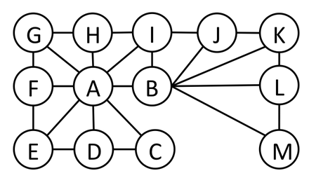
Cutset Quiz
Find the smallest cutset for the graph below.

Slide 51
Tree Decomposition*
Idea: create a tree-structured graph of mega-variables
Each mega-variable encodes part of the original CSP
Subproblems overlap to ensure consistent solutions
M1
M2
M3
M4
WA
≠
NT
NT
≠
Q
Q
≠
NSW
NSW
≠
V
≠
≠
≠
≠
≠
≠
≠
≠
SA
SA
SA
SA
Agree on shared vars
Agree on shared vars
Agree on shared vars
{(WA=r,SA=g,NT=b),
(WA=b,SA=r,NT=g),
…}
{(NT=r,SA=g,Q=b),
(NT=b,SA=g,Q=r),
…}
Agree: (M1,M2) ∈
{((WA=g,SA=g,NT=g), (NT=g,SA=g,Q=g)), …}

Slide 52
Next Time: Search when you’re not the only agent!

